Slide 1
Data Science in Healthcare (HW #02)
Presenter: S.Dulguun
Student ID: 20222045

Slide 2
Small ribosomal subunit protein 19 (es19)
Gene name: RPS19
Protein name: RPS19/es19
Alternative names:
ES19
S19
DBA
Loss Of Heterozygosity On Chromosome 19, Region 1
40S Ribosomal Protein S19
LOH19CR1
Source | ID
Ensembl | ENSG00000105372
NCBI gene | 6223
UniPortKB | P39019
Refseq | NM_001022
Pubmed | 36517592

Slide 3
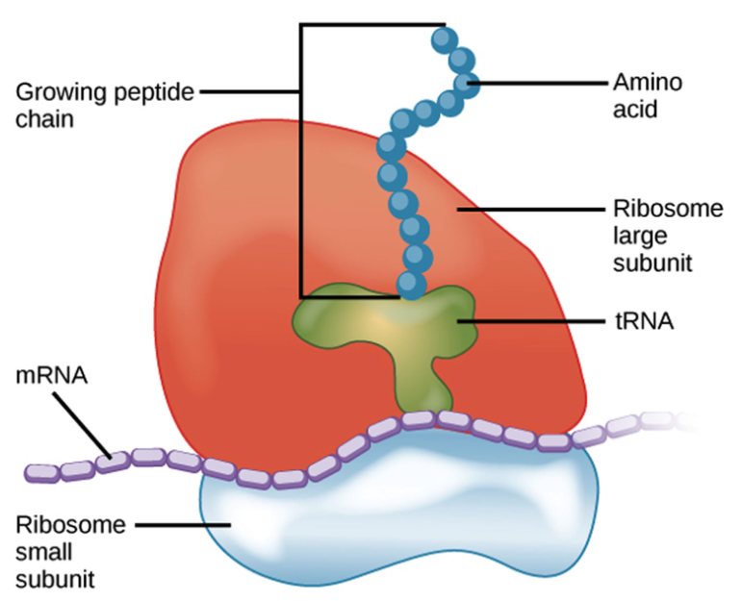

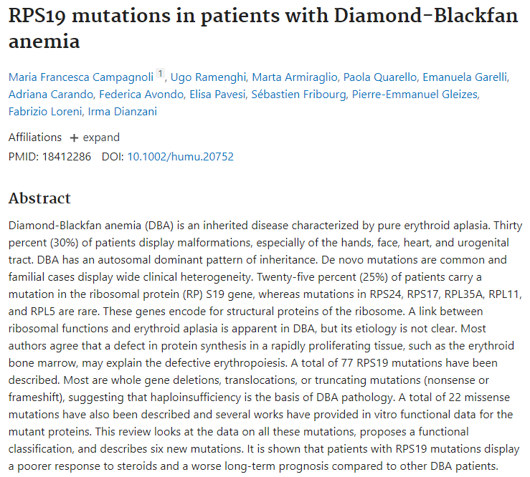
Phenotype relation of RPS19
Symptoms
Typical anemia | Pale skin
 | Sleepiness
 | Rapid heartbeat
 | Hear murmurs
Sometimes no physical feature
25% abnormal features | Face
 | Head
 | Hands (especially thumbs)
 | Organ defects

Slide 4
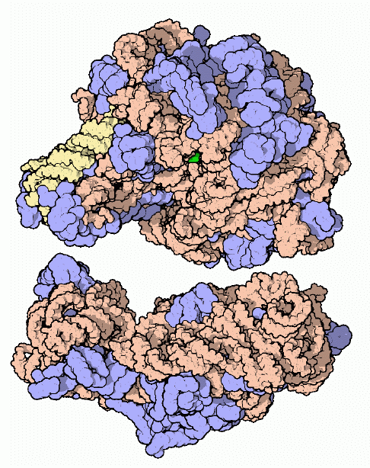
Function of RPS19
Ribosomes consists of small 40S and large 60S subunit
Together these subunits are composed of 4 RNA species and approximately 80 structurally distinct proteins.
It is located in the cytoplasm.
As is typical for genes encoding ribosomal proteins, there are multiple processed pseudogenes of this gene dispersed through the genome.

Slide 5
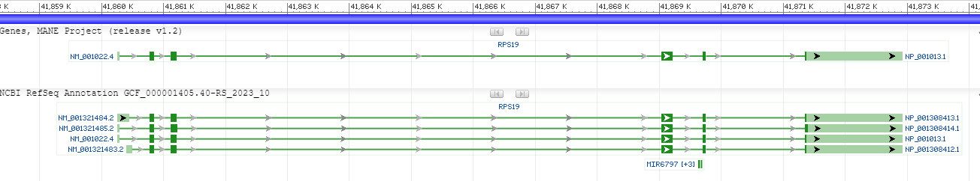
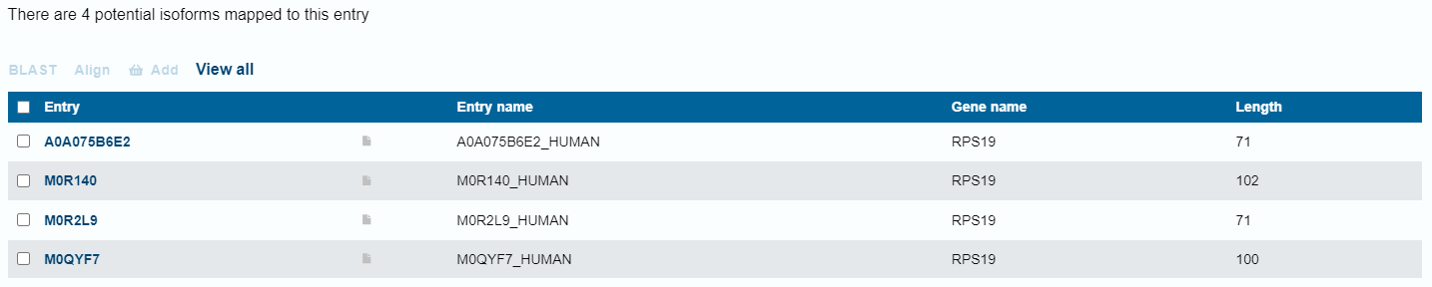
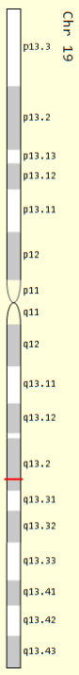
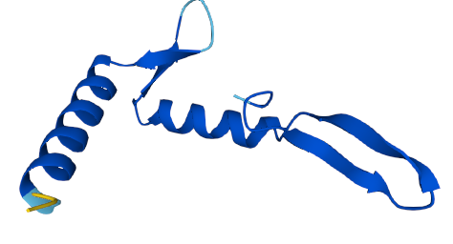
Position of on genome and splice variants
19q13.2
4 splice variants
Start site = 41860775 - 41860777
Stop site = 41871375 - 41871377

Slide 6
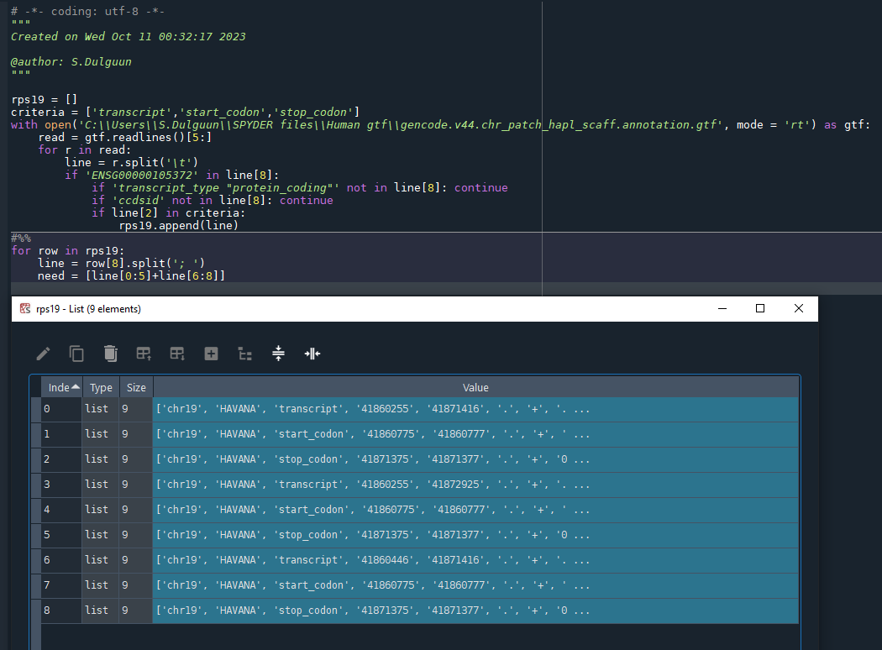
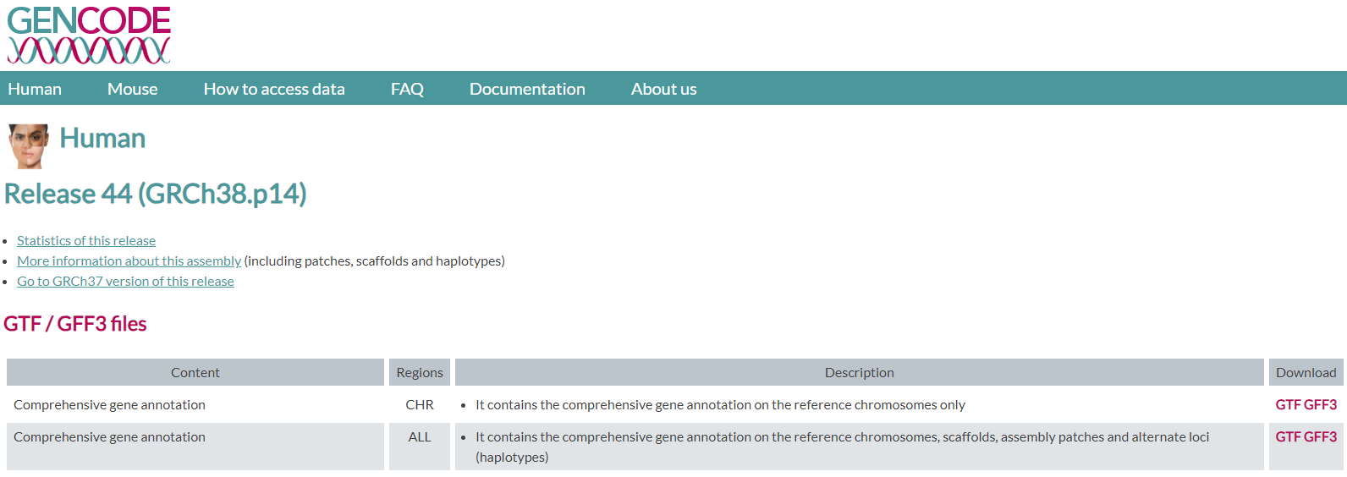
Method to find the start and stop position

Slide 7
Thank you for your attention!!!
Presenter: S.Dulguun
Student ID: 20222045

